Slide 1
Todolist Application
Phuong Tran

Slide 2
Technology Stacks
Database: In-memory H2 SQL database
Backend: Java Springboot
Frontend: React JS
Deploy environment: Azure

Slide 3
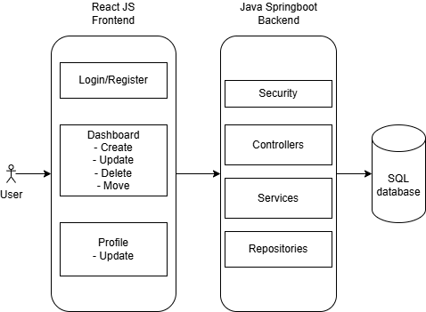
Overall flow

Slide 4
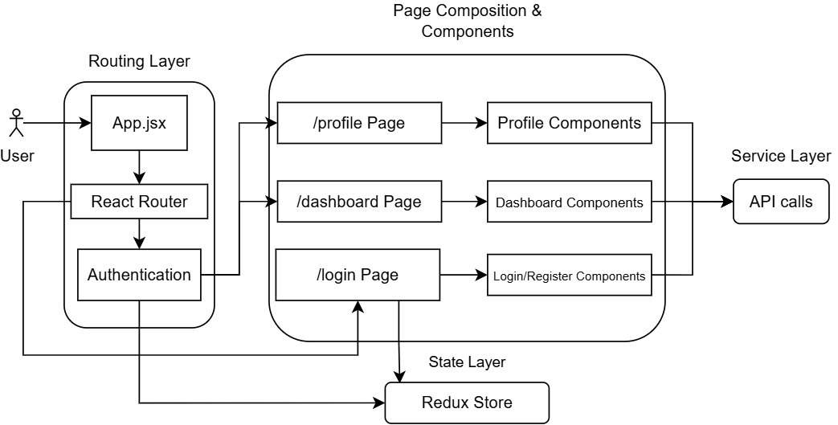
Frontend architecture

Slide 5
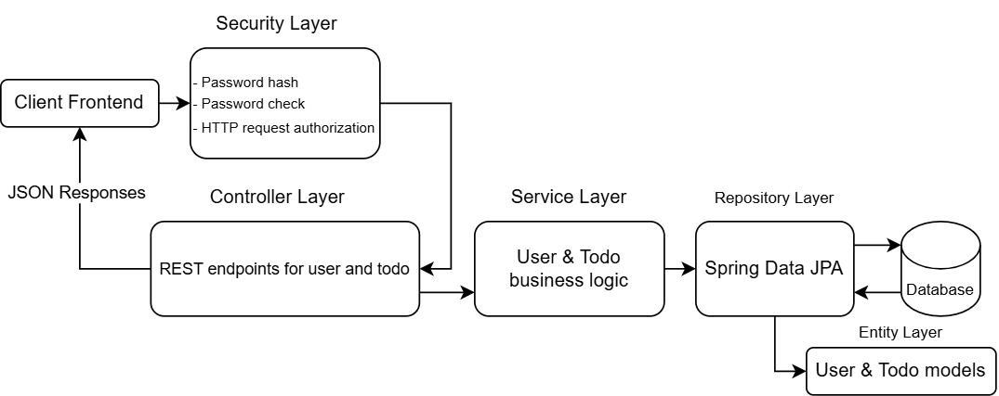
Backend architecture

Slide 6
Database Design
USERS
BIGINT | id | PK | IDENTITY
VARCHAR | user_name |  | NOT NULL
VARCHAR | hash |  | NOT NULL
TODOLIST
BIGINT | id | PK | IDENTITY
VARCHAR | task_name |  | NOT NULL
VARCHAR | task_description
BIGINT | task_order |  | NOT NULL
DATE | task_date |  | NOT NULL
BIGINT | owner_id | FK | NOT NULL

